Slide 1
Modeling Passive Daytime Radiative Cooling Devices (PDRCs) using COMSOL Multiphysics™
Student: Collins Munene Kariuki
Advisor: Professor Janice Hudgings

Slide 2
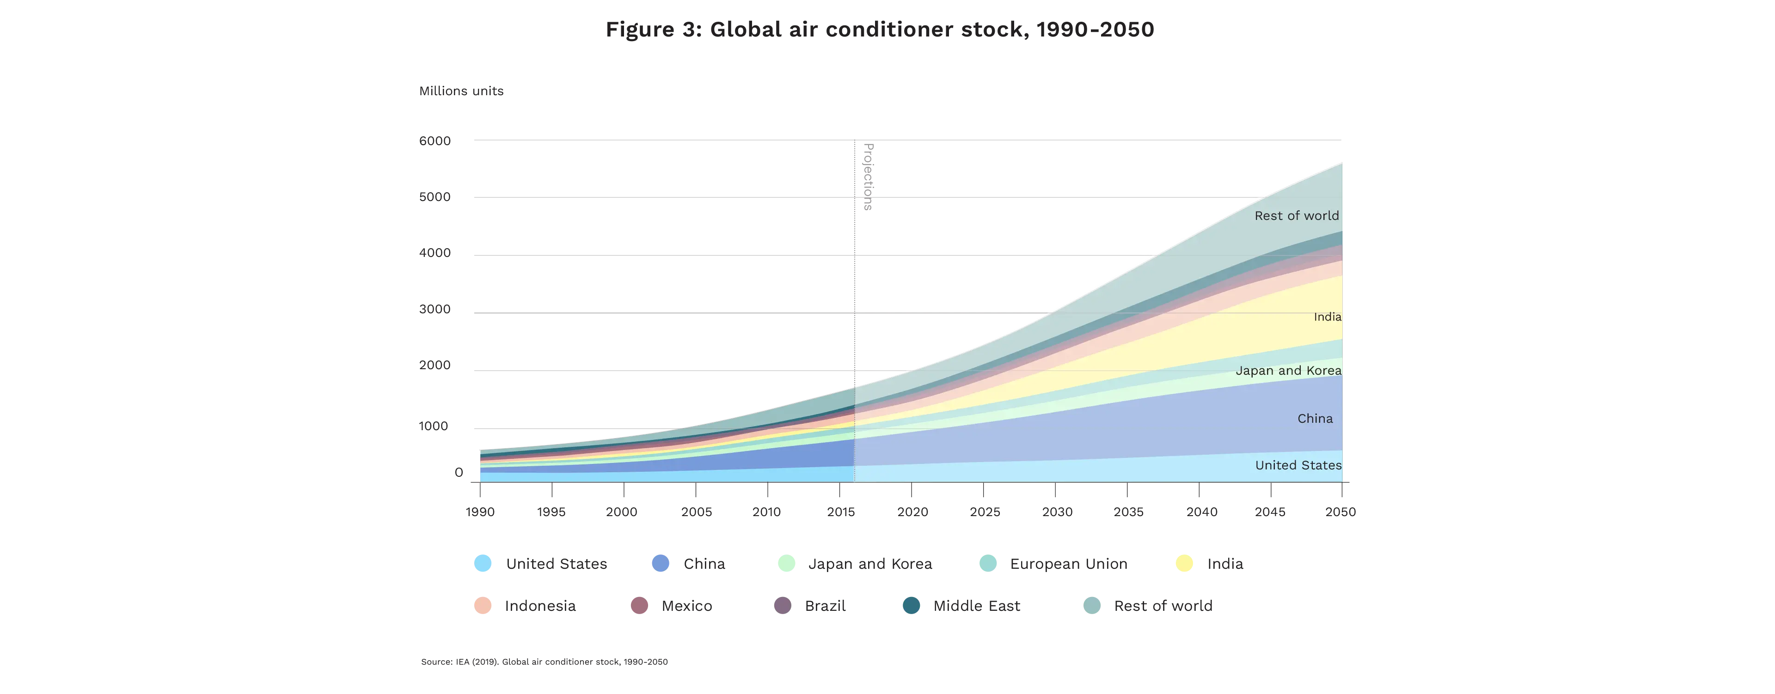
Motivation.
Global warming
More emissions and heat dumped outside
More AC use
By 2050, around 2/3 of the world’s households could have an AC. China, India and Indonesia will together account for half of the total number.

Slide 3
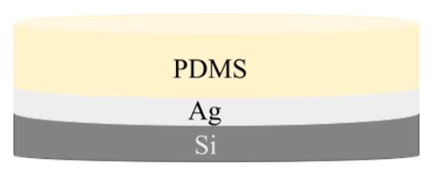
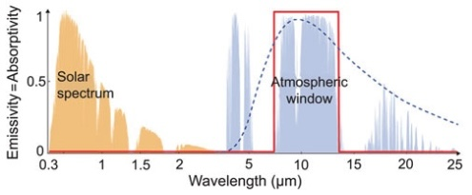
So, What are PDRCs?
Radiative passive cooling occurs when objects emit more radiation than the combined radiation they absorb thus dissipating heat away from an object.
Thus, radiative passive cooling is an electricity-free method for cooling terrestrial entities
Modeling and Testing Passive Daytime Radiative Cooling Devices (DiBari, 2023)
Passive Daytime Radiative Cooling: Principle, Application, and Economic Analysis (Yang & Zhang, 2020)
0% absorptivity (100% reflectance) in the solar spectrum (0.3–2.5 μm), so the surface is not heated by sunlight in daytime at all.
Emittance of ~100% in the λ = 8–13 μm window of the atmosphere, where it is partially transparent, since there is limited infrared absorption by gas molecules.

Slide 4
Thesis Goals.
Use COMSOL to model PDRCs but COMSOL is… hard
Plotting the reflectance (R) vs wavelength for the basic Si + Ag + PDMS structure.
Understanding how to use COMSOL Multiphysics (proof of concept)
To do this I verify simulations on (anti)-reflectivity by benchmarking them against established optics literature.
- Modeling anti-reflectance coatings.
- Modeling (multi-layer) high reflectance coatings.

Slide 5
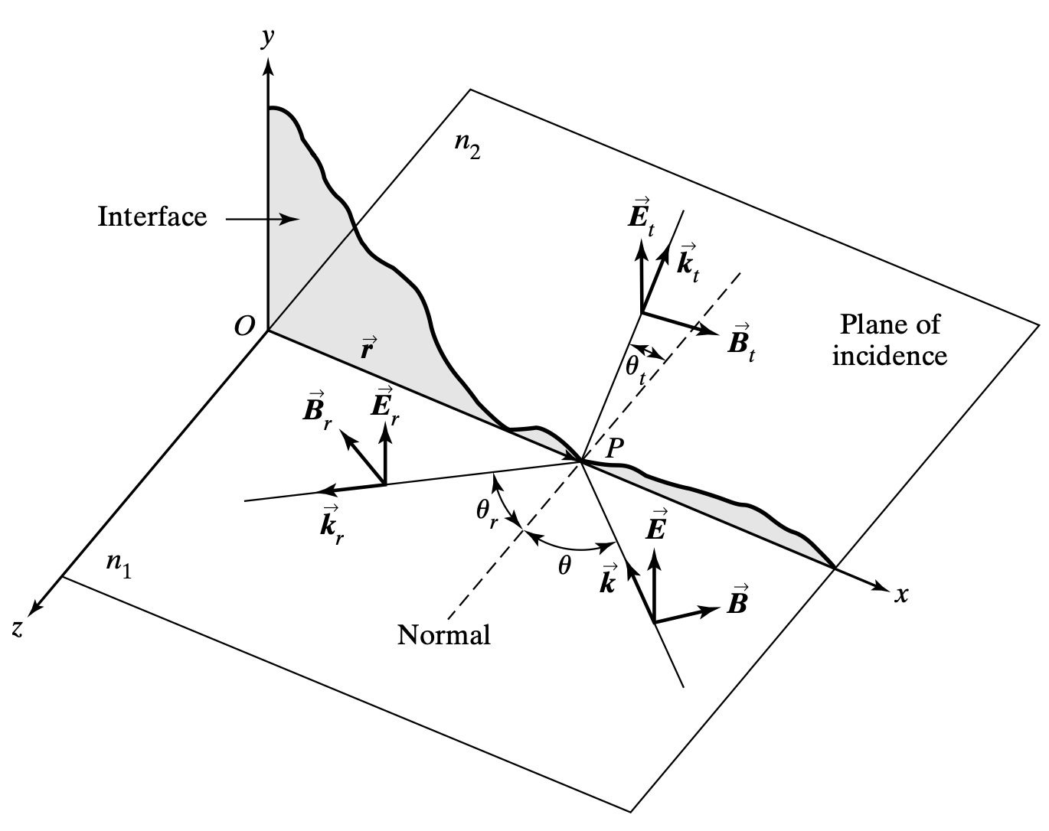
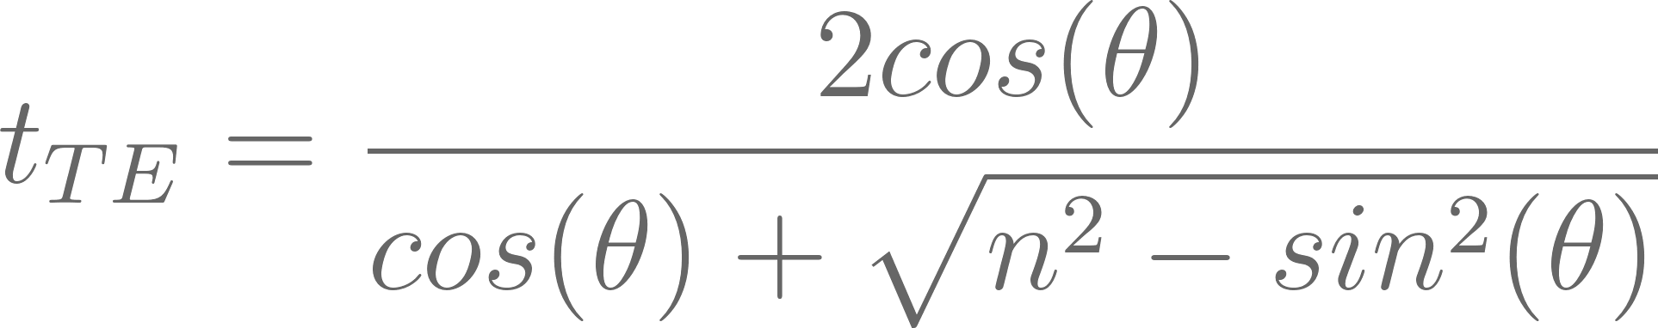
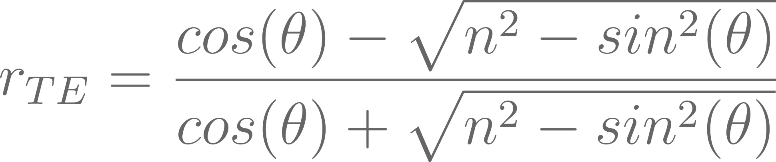
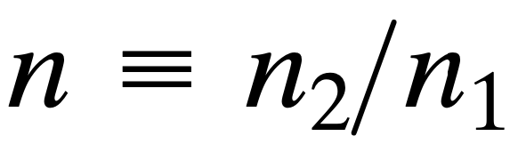
Theory (Single Interfaces & Fresnel Equations)
F. L. Pedrotti, L. M. Pedrotti, and L. S. Pedrotti, Introduction to optics, 3rd ed. 2007.
The Fresnel Equations determine the proportion of light that is reflected or transmitted at the interface, based on the incident angle and the polarization of the light.

Slide 6
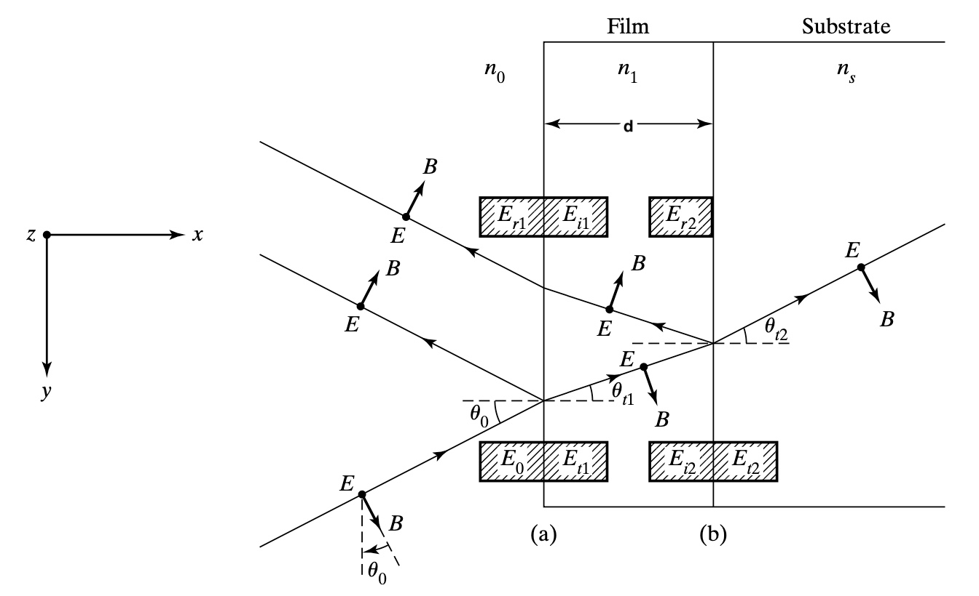
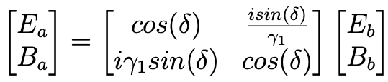
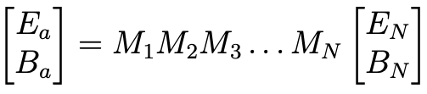
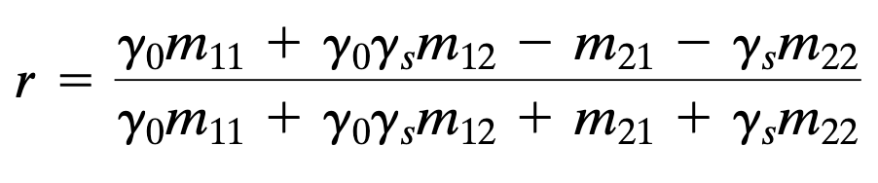
Theory (Multiple Interfaces & the Transfer Matrix)
When light encounters multiple interfaces the complexity of reflection and transmission calculations increases significantly.
The transfer matrix approach allows for the systematic calculation of light behavior through multiple layers with varying refractive indices and thicknesses.
n is a function of the wavelength (λ) of light… we need COMSOL!!
F. L. Pedrotti, L. M. Pedrotti, and L. S. Pedrotti, Introduction to optics, 3rd ed. 2007.

Slide 7
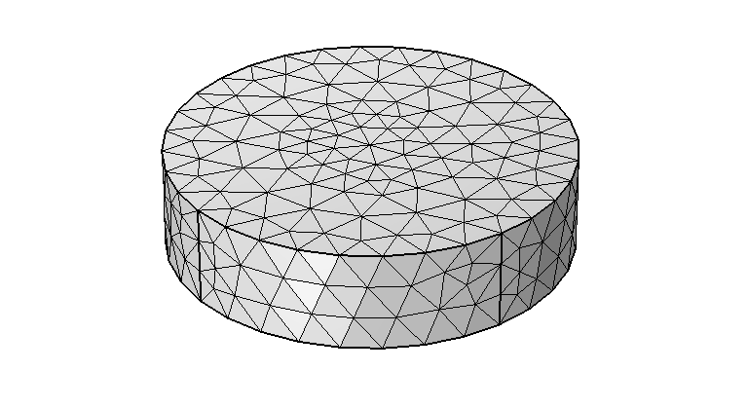
COMSOL Multiphysics ™
Initialization of the modelling environment
Geometry construction
Material property specification
Physics boundary conditions
Mesh generation
Simulation execution
Results post-processing
Normal-sized mesh
Notes:
COMSOL Multiphysics is a powerful simulation software that allows users to model and solve complex engineering, scientific, and mathematical problems across various physics and engineering disciplines.
It utilizes the finite element method to analyze multi-physics phenomena, enabling researchers and engineers to create, experiment, and optimize designs in a virtual environment.

Slide 8
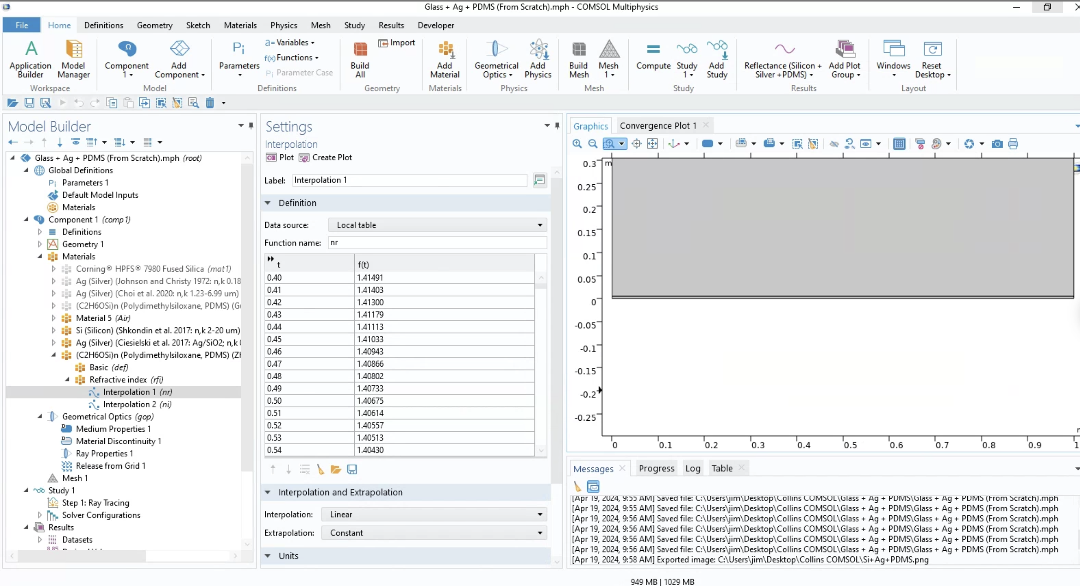

Slide 9
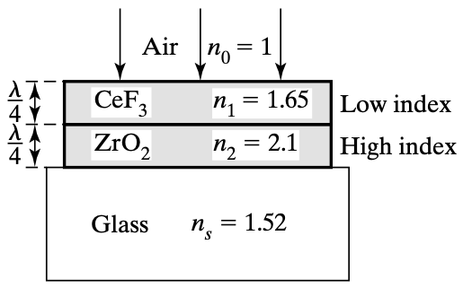
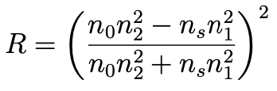
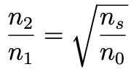
Validation of Models Against Established Literature
Anti-reflectance coatings are designed to minimize reflection and maximize transmission of light through strategic manipulation of refractive indices across different layers.
F. L. Pedrotti, L. M. Pedrotti, and L. S. Pedrotti, Introduction to optics, 3rd ed. 2007.

Slide 10
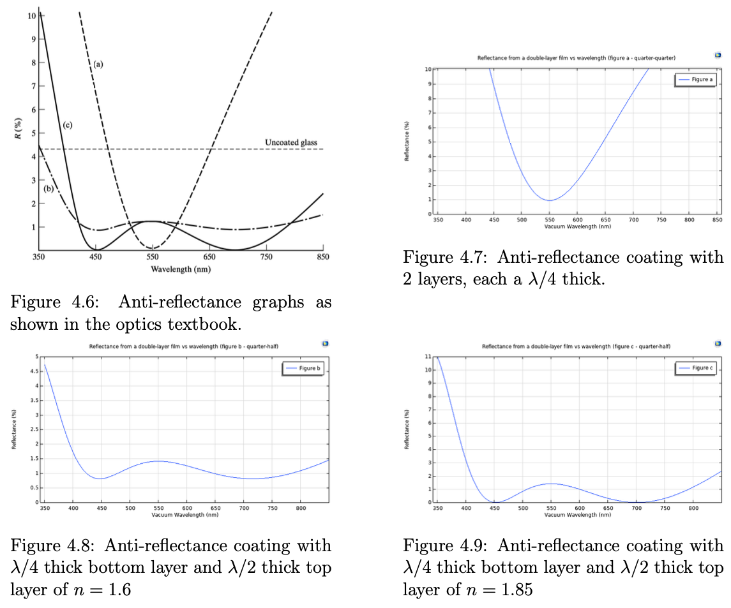
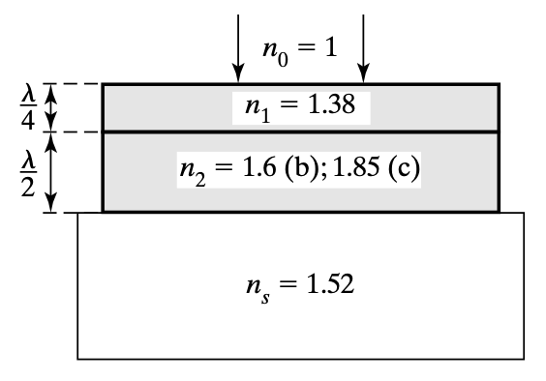
Validation of Models Against Established Literature
COMSOL
THEORY
F. L. Pedrotti, L. M. Pedrotti, and L. S. Pedrotti, Introduction to optics, 3rd ed. 2007.
COMSOL
COMSOL

Slide 11
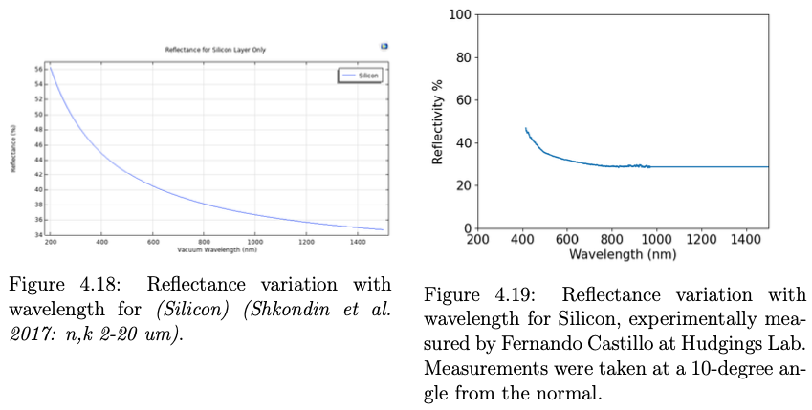
PDRC Device Modeling (Silicon Only)
EXPERIMENT
COMSOL

Slide 12
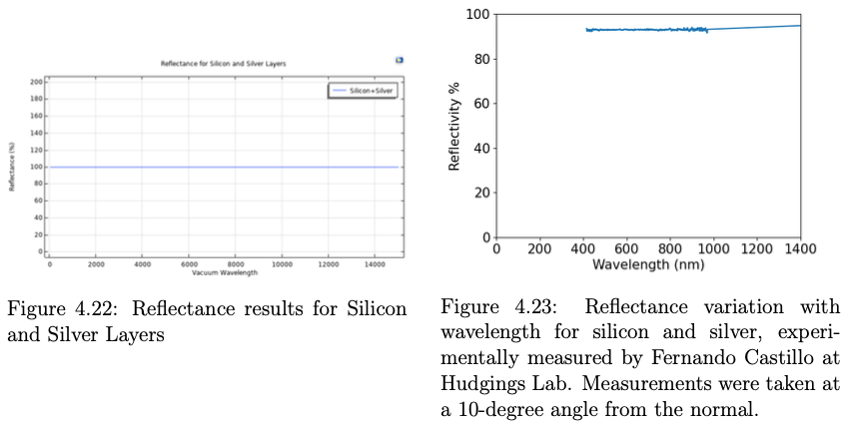
PDRC Device Modeling (Si + Ag)
EXPERIMENT
COMSOL

Slide 13




Conclusions and Future Work
Successfully modeled and validated anti-reflectance coating, (multi)-layer high-reflectance coatings, Fresnel equations etc.
COMSOL is a versatile tool for simulating a wide range of phenomena across various physics disciplines.
Enhance the PDRC design by layering additional materials atop the PDMS layer, experimenting with various thicknesses and refractive indices to more efficiently harness constructive interference across multiple interfaces.
Development of reflectance versus angle of incidence models to aid in the characterization of PDRC behavior throughout the day.

Slide 14











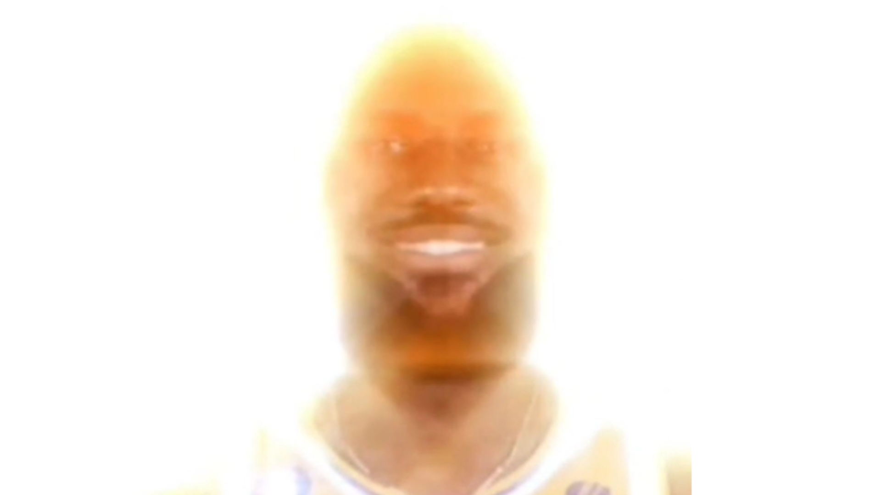

Acknowledgements
FACULTY
HUDGINGS LAB
ORGANIZATIONS
Koh Rombouts Goldman Sachs Scholarship Fund
Herbert Levy Memorial Scholarship & SPS-Google Scholarship
James Wu
Fernando Castillo
Leah McCarthy
Prof. Hudgings
Dr. Higdon
Rose Sinkus
Haakon Pihlaja
Glenn Partsch
PHYSICS & ASTRONOMY DEPARTMENT
Prof. Moreno
FRIENDS
Claremont Christian Fellowship
Sontag Suite 310 (Ulisses, Justin, and Fernando)
UCRI – Ulisses, Ru, Ishan
CIL – Ishan, Lukas
And all my other fellas.
FAMILY
Sarah Sucher
Nora Wu

Slide 15
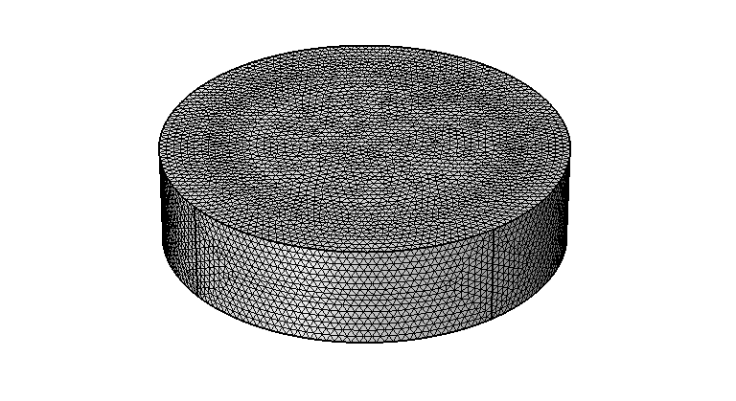
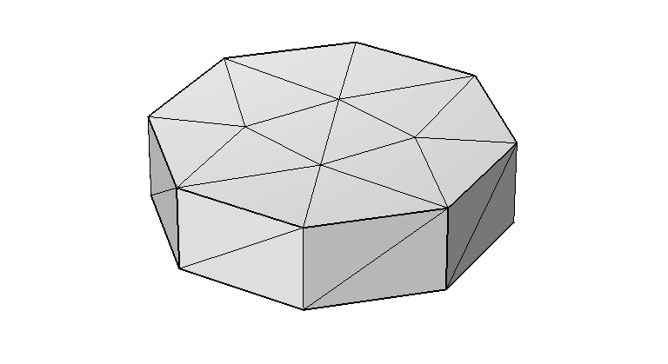
Appendix (the Mesh)
Divides the model’s geometry into smaller, discrete elements, such as prisms in 3D, or triangles in 2D.
Discretization: The mesh breaks down a continuous domain into discrete pieces, allowing for the numerical solution of partial differential equations that describe the physics of the problem.
Extremely fine mesh
Normal-sized mesh
Extremely coarse mesh
The density and quality of the mesh influence the accuracy of the results. A finer mesh can provide more precise solutions but requires more computational power.
Notes:
Yes, that's a correct and succinct way to describe the process. Discretizing the geometry into a mesh breaks the model into smaller, manageable elements where local solutions to the governing equations are computed. The program then intelligently combines these local solutions, considering the boundary and continuity conditions at the interfaces between elements, to construct a solution for the entire domain.
It’s not just simple summation, though. The combination involves complex numerical methods that ensure the physical laws are satisfied throughout the entire domain. This aggregate solution gives insights into the spatial distribution of the physical quantities, such as temperature variations, electromagnetic fields, stress distribution, or fluid flow patterns, across the entire geometry being modeled.

Slide 16
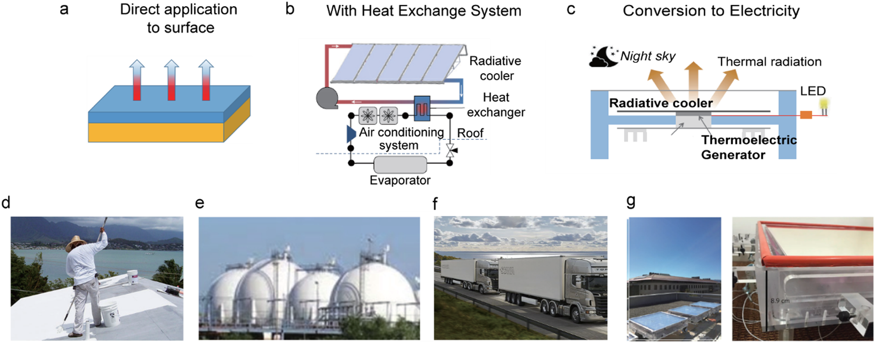
PDRCs, They’re Not Just a Pipe Dream
Y. Yang and Y. Zhang, “Passive daytime radiative cooling: Principle, application, and economic analysis,” 2020
Notes:
Building Envelopes: PDRC coatings on buildings can reduce energy consumption and CO2 emissions, with the effectiveness depending on location and weather. The coatings are particularly suitable for hot regions.
Vehicles: PDRC can reduce the air conditioning load in vehicles, thereby increasing their mileage, especially in electric vehicles. This is important for trucks in the cold chain and oil tankers where maintaining low temperatures is crucial.
Containers: Containers that require a cool environment for transporting food and temperature-sensitive goods can benefit from PDRC coatings. This also applies to containers with energy storage systems that need significant cooling.
Energy Storage Tanks: PDRC paints or films can be applied to surfaces like oil storage tanks where temperature control is vital for safety and quality maintenance.
Heat Exchanger Systems: In applications involving a fluid-based heat exchanger, PDRC systems can be decoupled from the cooling target, providing controllable cooling power. For example, PDRC panels can be integrated into designs that enhance their protection and extend their operational life.
Electricity Generation: PDRC surfaces can be used alongside heat-to-electricity conversion methods to generate electrical power, useful for off-grid applications, emergencies, and as a supplement to solar power.

Slide 17
Alternatives to Silver
Some alternatives to silver layers in PDRCs include porous materials like fluoropolymers (such as PVdF-HFP with porosity), which achieve high solar reflectance and thermal infrared emittance.
Other materials include delignified wood, which turns white due to its mesoporous structure and offers similar properties . Additionally, porous alumina, SiO2, and PTFE are mentioned as viable alternatives.
These materials are designed to maximize reflectance while maintaining good emissivity, reducing the need for silver, which can be expensive and less durable under certain conditions.

